Slide 1
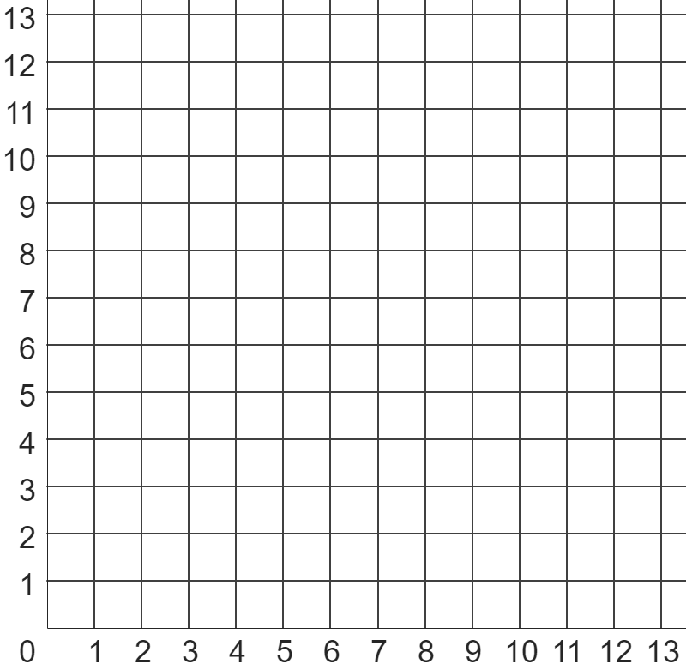
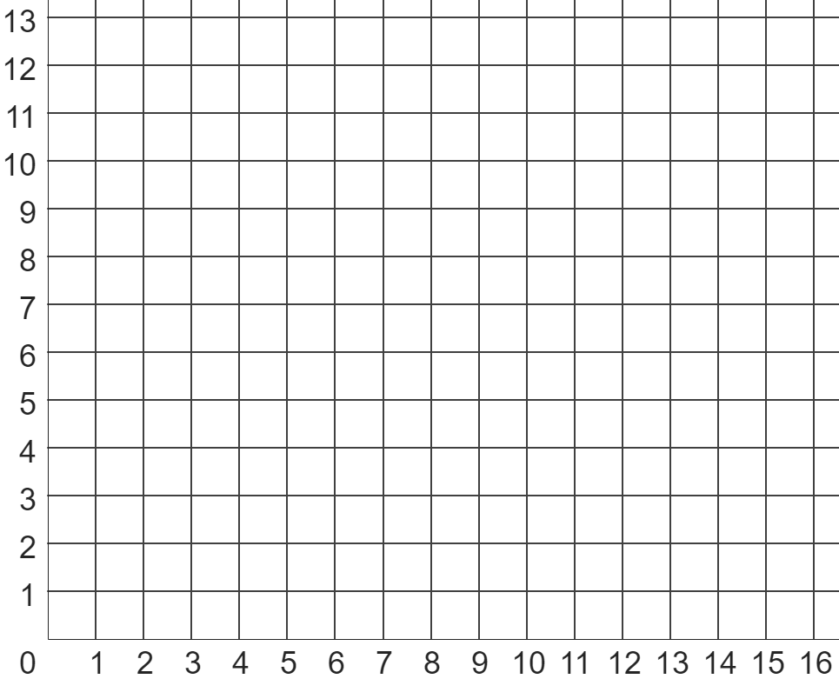
Problem solving with similarity and Pythagoras’ theorem
Task A: Pythagoras’ theorem with coordinates
B
1) Use Pythagoras’ theorem to find the shortest distance (to 1 d.p) between points:
A
a) A and B
b) A and C
c) B and D
d) C and D
e) B and E
C
D
E
scalene
triangle
2) Calculate the perimeter of each shape (to 2 d.p.).
square
isosceles
triangle
3) Write down three coordinates whose vertices make a triangle with a perimeter of between 20 and 22 units in length.
Show this is correct using Pythagoras’ theorem.

Slide 2



Problem solving with similarity and Pythagoras’ theorem
Task B: Pythagoras’ theorem with ratios
1) Each of these three widescreen TVs have width and height in the ratio 16 : 9.
8 inches
12 inches
a) Complete each sentence by choosing the appropriate word below.
screen A
Each of the TVs is ___________ to the others.
screen B
This is because their _________ and _________ are in ___________ to each other.
The ___________ from screen A to B is 1.5.
30 inches
proportion
scale factor
width
congruent
height
similar
screen C
b) By using Pythagoras’ theorem, complete the ratio table for screen B (3 d.p.)
width | height | diagonal
16 | 9
 |  | 12
c) Hence, calculate the width of screens A and C (2 d.p.)
2) Izzy wants to buy this ultra widescreen TV, which has a width and height in the ratio 22 : 9.
The TV has a 35 inch screen, and a stand that is 2 inches high.
Will the TV fit inside her TV cabinet?
TV cabinet
36 inches
15 inches
width | height | diagonal
ultra widescreen
22 : 9
aspect ratio

Slide 3
Problem solving with similarity and Pythagoras’ theorem
3) Jacob sees three TVs for sale, each having a 28 inch screen.
Jacob wants to buy the TV whose screen has the largest area.
Which TV should he buy?
retro TV (4 : 3 aspect ratio)
widescreen TV (16 : 9 aspect ratio)
ultra widescreen TV (22 : 9 aspect ratio)
Mathematics in Education and Industry.
v2.3

